Slide 1


RentIT
The Ultimate Source of Entertainment

Slide 2

Introduction
What is RentIT ? - It is an online DVD rental system.
For Whom? (Movie Lovers)
Administrator
Customer
Techonology – PHP, MySQL , Javascript and CSS.

Slide 3

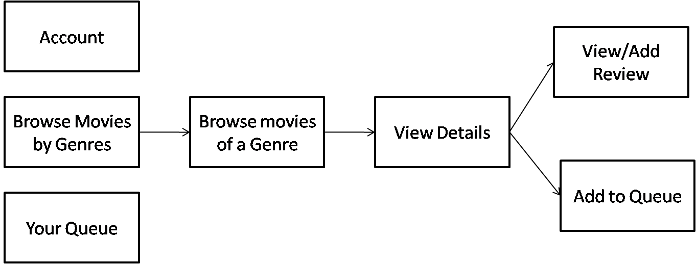
Customer End

Slide 4
Screenshots for Customer

Slide 5

RentIT – for Customer
User Account
Movies by genres
Add movies to queue
Movie reviews

Slide 6
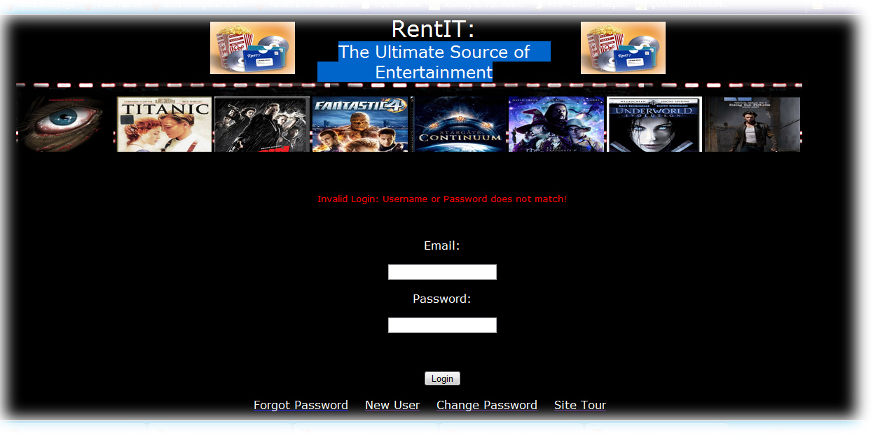
Screenshots-Login Page-

Slide 7
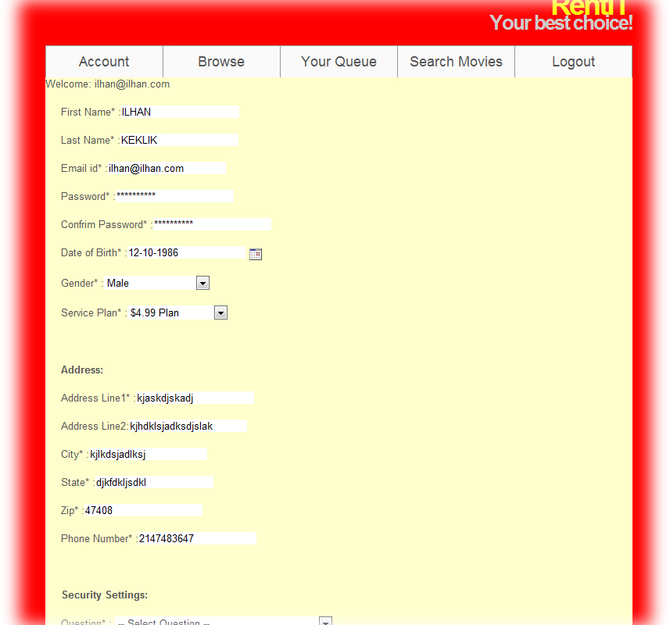
Screenshots-Account Page-

Slide 8
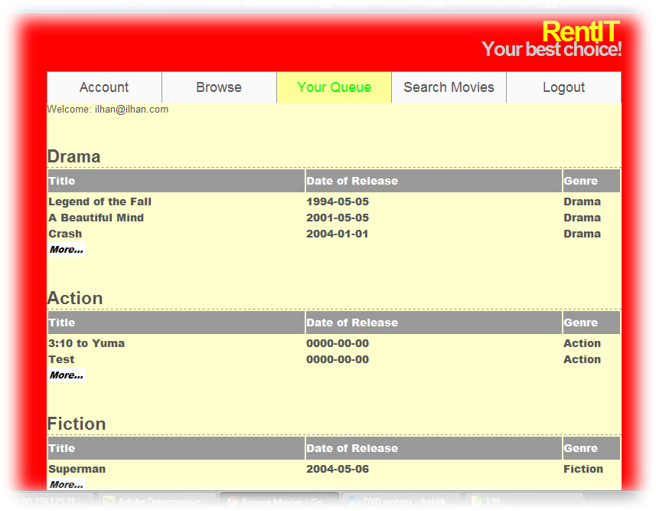
Screenshots-List of Movies-

Slide 9
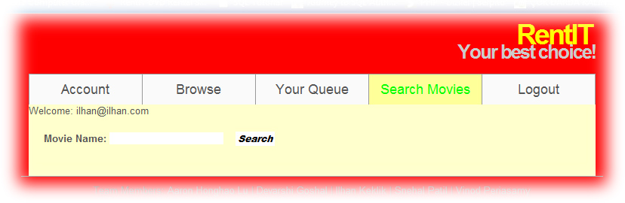
Screenshots-Search Movie-

Slide 10
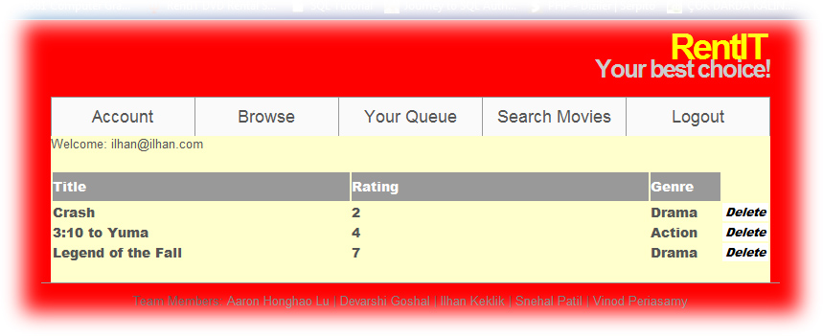
Screenshots-My Queue-

Slide 11
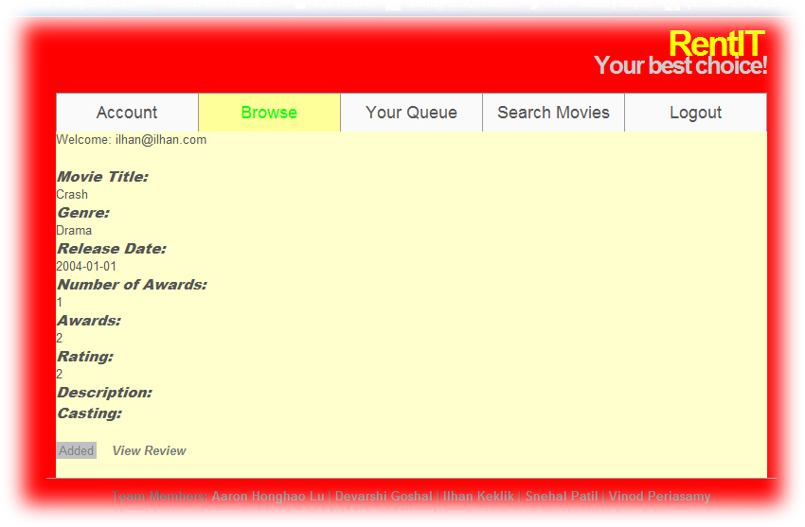
Screenshots-View Movie-

Slide 12
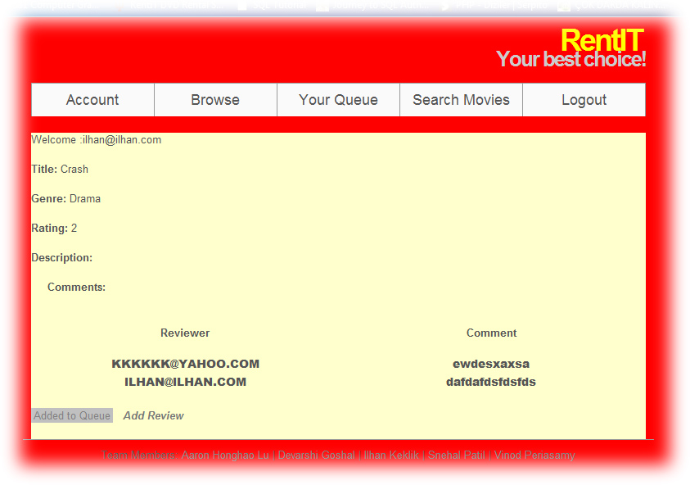
Screenshots-Movie Reviews-

Slide 13
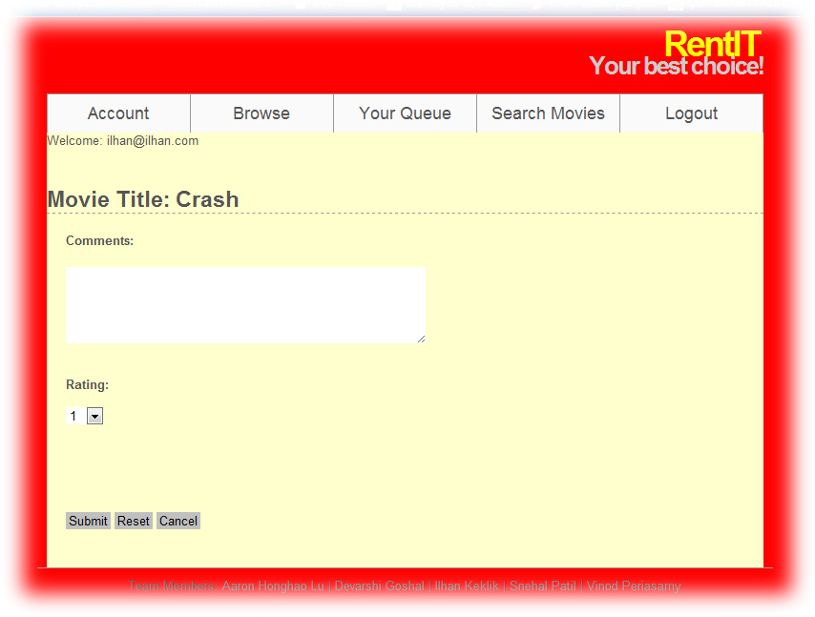
Screenshots-Add Review-

Slide 14
Screenshots-Add Review-

Slide 15
RentIT – for Administrator
Movie management:
Add new movies
View movies
Add casting
View casting
User management:
User Report
User Rent History - return
Approve Rent Order
System settings:
Service Plan

Slide 16
RentIT – for Administrator
Movie management:
Add new movies
View movies
Add casting
View casting
User management:
User Report
User Rent History - return
Approve Rent Order
System settings:
Service Plan

Slide 17
Screenshots for Admin

Slide 18

Screenshots-Login Page-

Slide 19
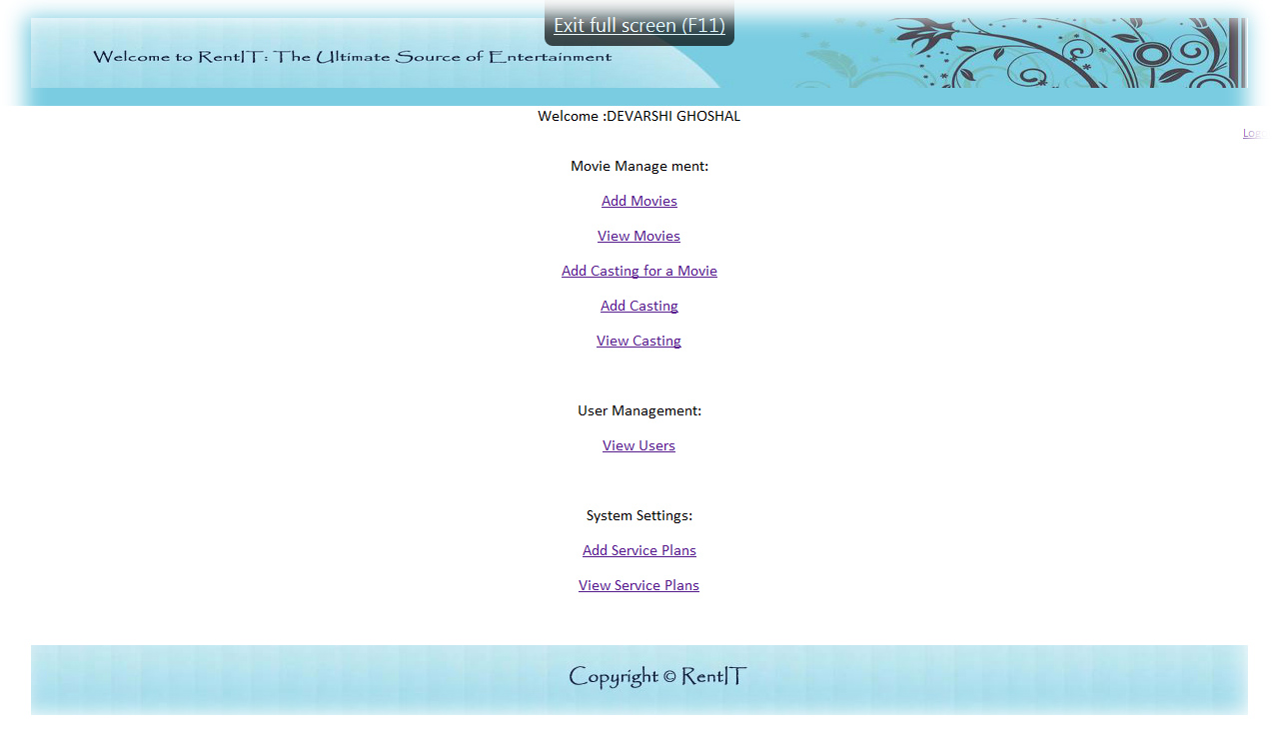
Screenshots-Admin Menu-

Slide 20
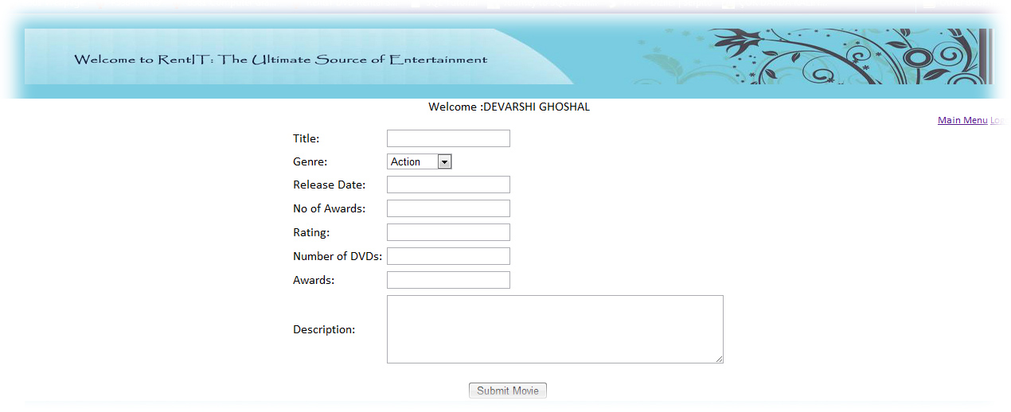
Screenshots-Add Movies-

Slide 21
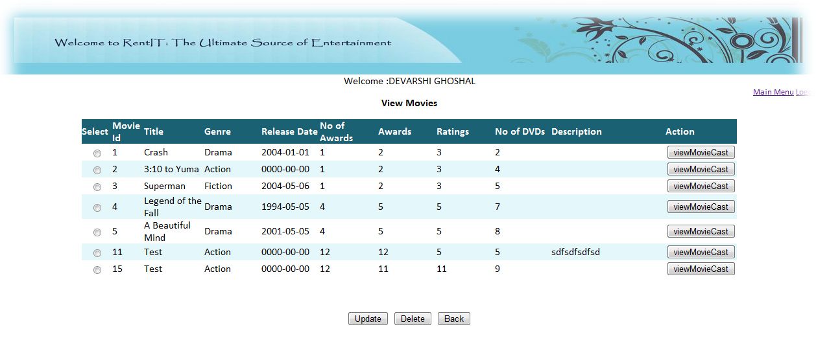
Screenshots-View Movies-

Slide 22

Screenshots-Add Casting for a movie--

Slide 23

Screenshots-Add Casting-

Slide 24
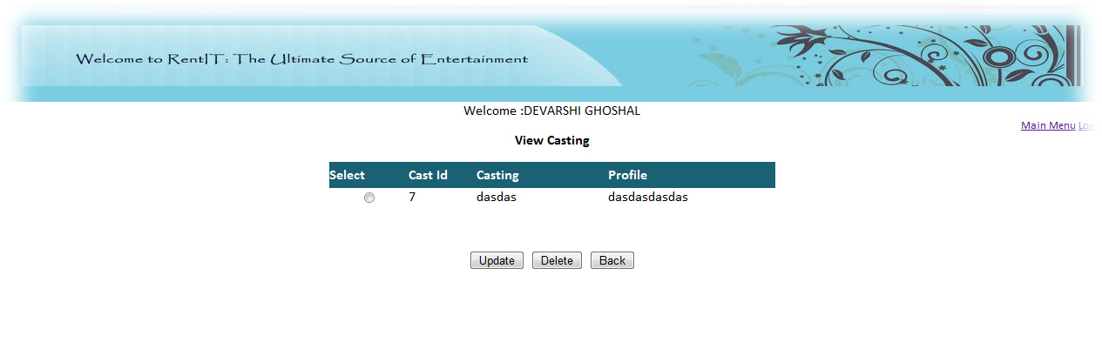
Screenshots-View Casting-

Slide 25
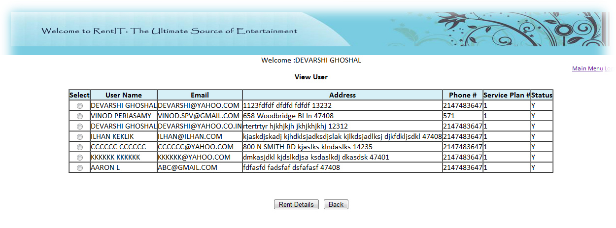
Screenshots-View Users-

Slide 26
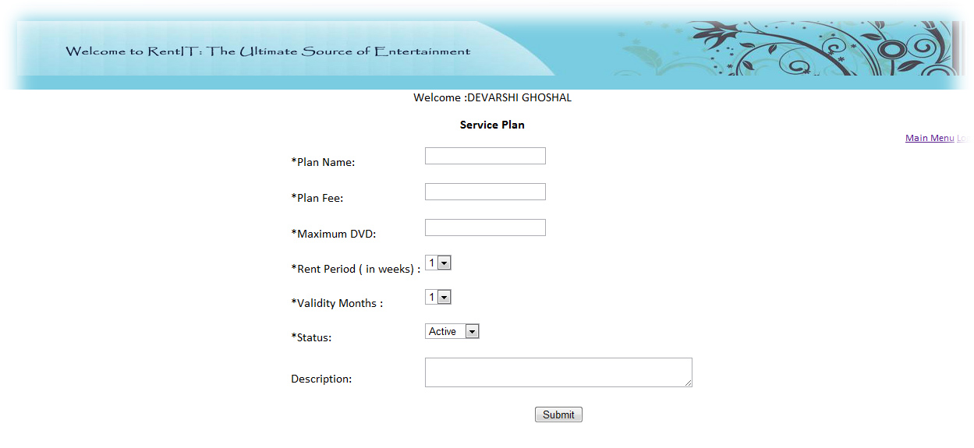
Screenshots-Add Service Plan-

Slide 27
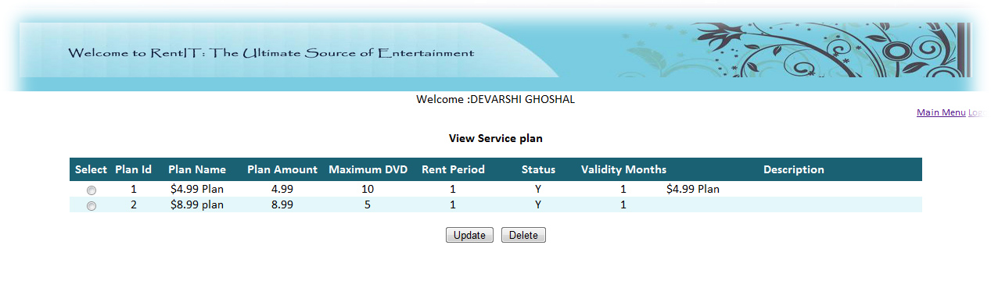
Screenshots-View Service Plan-

Slide 28

Future Enhancement

Slide 29
Questions?

